Slide 1
SQL 문법 – 본 교재 외 내용 추가

Slide 2
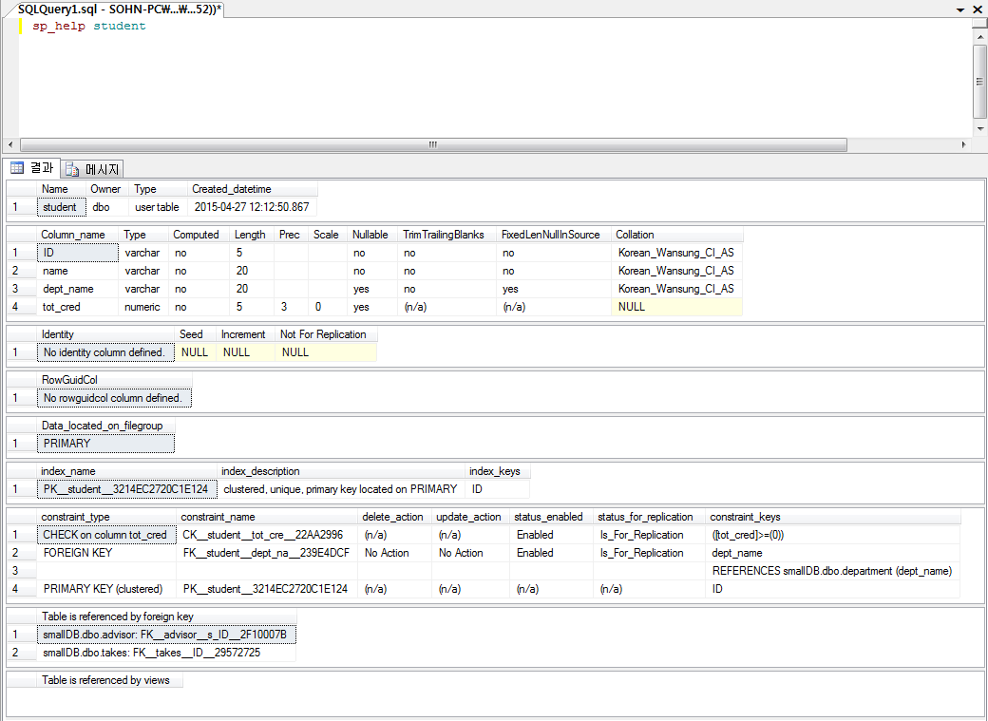
테이블 구조 확인: sp_help
sp_help student

Slide 3
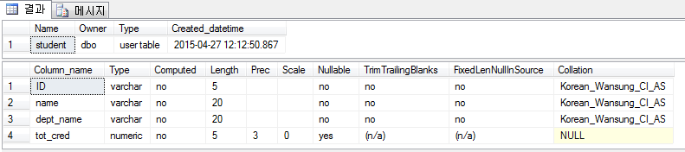
테이블 스키마 변경: alter column
alter table student
alter column dept_name varchar(20) not null
sp_help student

Slide 4
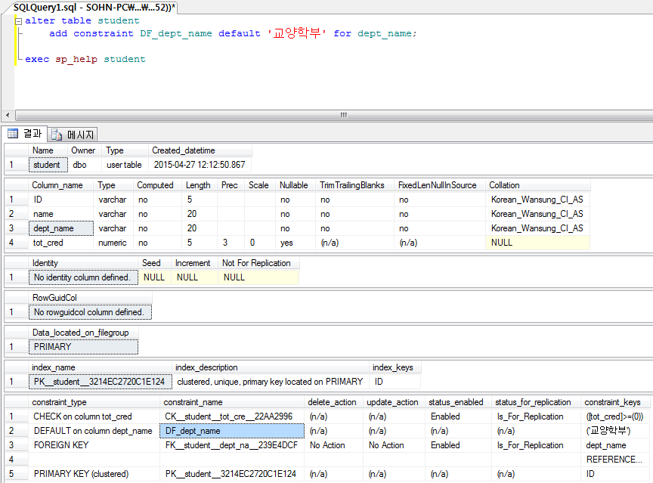
테이블 스키마 변경: add constraint
alter table student
add constraint df_dept_name default ‘교양학부’ for dept_name
sp_help student

Slide 5
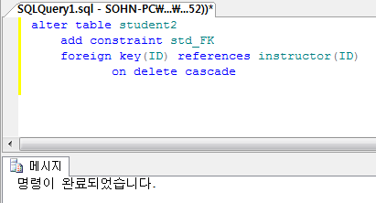
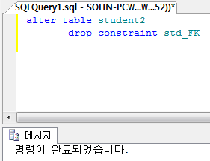
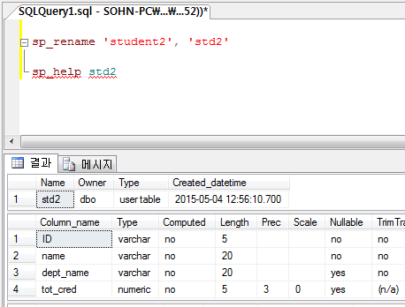
테이블 스키마 변경
Foreign key 추가
  alter table student2
add constraint std_FK
foreign key(ID) references instructor(ID)
on delete cascade
constraint 제거
  alter table student
  drop constraint std_FK
table 이름 변경
  sp_rename ‘student2’, ‘std2’

Slide 6
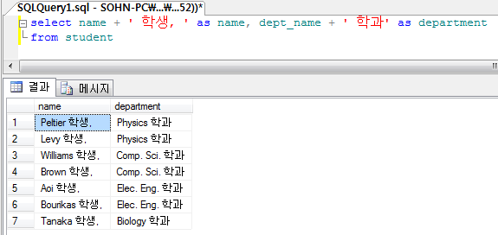
검색 결과 값과 문자열 결합
select name + ' 학생, ', dept_name + ' 학과‘ from student

Slide 7
Built-in Function-1
함수: Built-in Function, User-defined Function
Build-in Function
  SQL을 더욱 강력하게 함
  데이터 값 조작 간편
  Vendor 별로 큰 차이가 있음
  문자형 함수: Lower, Upper, Substring, Length, Ltrim, Rtrim, ASCII
  숫자형 함수: ABS, MOD, ROUND, TRUNC, SIGN, CHAR, CEILING, FLOOR, EXP, LOG, LN, POWER, SIN, COS, TAN
  날짜형 함수: GETDATE, DATEPART(‘YEAR’|’MONTH’|’DAY’, d)
  변환형 함수: CAST, CONVERT
  NULL 관련 함수: ISNULL, NULLIF

Slide 8
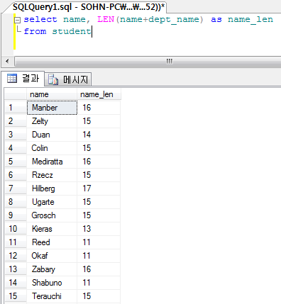
Built-in Function: LEN
select name, LEN(name+dept_name) as name_len
from student

Slide 9
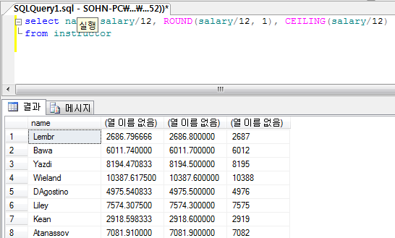
Built-in Function: ROUND, CEILING
select name, salary/12, ROUND(salary/12, 1), CEILING(salary/12)
from instructor

Slide 10
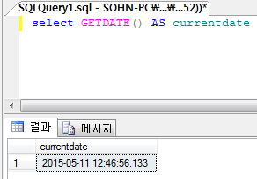
Built-in Function: GETDATE()
select GETDATE() AS currentdate

Slide 11
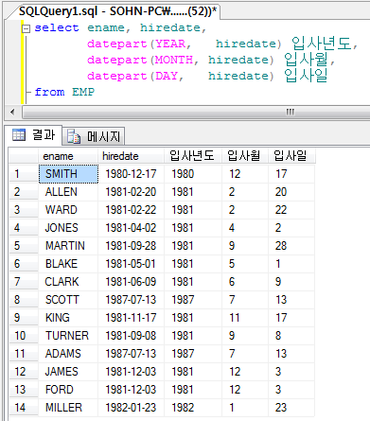
Built-in Function: DATEPART
DB: ‘부서-사원’ 으로 전환
select ename, hiredate,
datepart(YEAR, hiredate) 입사년도,
datepart(MONTH, hiredate) 입사월,
datepart(DAY, hiredate) 입사일
from EMP

Slide 12
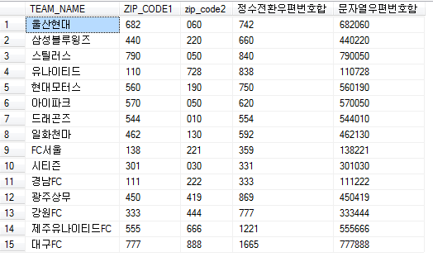
Built-in Function: CAST
DB: ‘K리그’ 로 전환
select TEAM_NAME, ZIP_CODE1, zip_code2,
CAST(ZIP_CODE1 as int) + CAST(zip_code2 as int) as 정수전환우편번호합,
ZIP_CODE1 + ZIP_CODE2 as 문자열우편번호함
from team

Slide 13
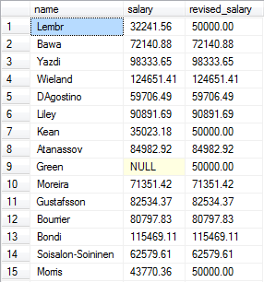
Built-in Function: CASE
select name, salary,
case when salary > 50000 then salary
else 50000
end revised_salary
from instructor

Slide 14
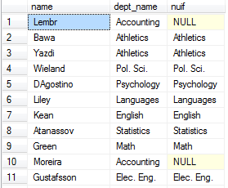
Built-in Function: NULLIF
컬럼 내용이 주어진 조건과 동일하면 NULL을 반환
select name, dept_name, nullif(dept_name, 'Acocounting') nuif
from instructor
  select name, dept_name,
  case when dept_name = 'Accounting' then null
  else dept_name
  end nuif
  from instructor 와 동일

Slide 15
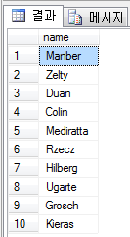
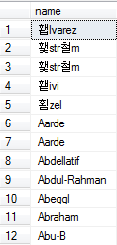
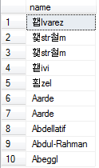
조회 결과 일부분만 접근
select top(10) name from student
  Top 10개를 임의로 추출함
  TOP (expression) [percent][with ties]
select top(10) name from student
order by name
  Ordering 후 top 10개를 추출함
select name from student
order by name

Slide 16
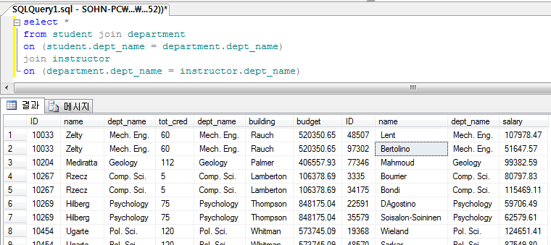
다중 테이블 조인
  학생이 소속된 학과와 그 학과에 소속된 교수에 대한 내용 조회
  select *
  from student join department
  on (student.dept_name = department.dept_name)
  join instructor
  on (department.dept_name = instructor.dept_name)

Slide 17
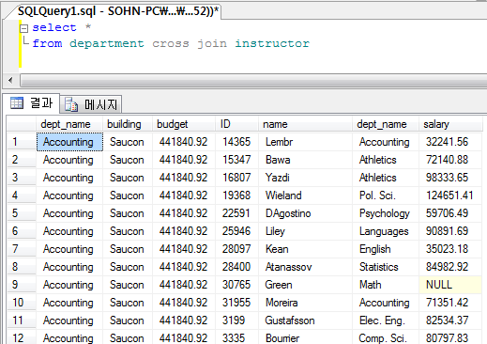
Cartesian Product: cross join
Cartesian product를 보다 명시적으로 기술: cross join
  select *
  from department cross join instructor
  select *
  from department, instructor

Slide 18
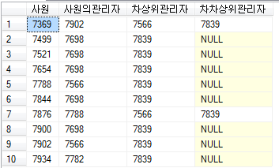
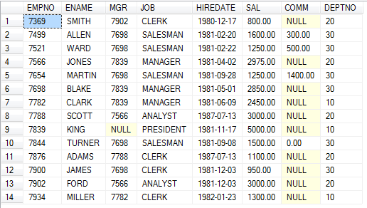
Self Join
select e1.empno 사원, e1.mgr 사원의관리자, e2.mgr 차상위관리자, e3.MGR 차차상위관리자
from EMP e1, EMP e2, EMP e3
where e1.MGR = e2.EMPNO and
e2.MGR = e3.empno
order by e1.empno
  select * from emp

